Slide 1


WILD Water Commission
Budget 2027
Presented August 31, 2026

Slide 2


Agenda:
Recap – Budget Process
Observations to Note
Draft Budget Overview
Budget Analysis, Summary
Next Steps

Slide 3
Reminder: WILD Budget Process
Draft Based on Business Plan Foundations:
  Spot Revisions and Adjustments to Adapt to Reality
Multi-Step Annual Budget Process:
  Preliminary Draft & Review, Member Engagement, Finalization & Adoption
Companion Bylaw to Complete the Process:
  Annual Water Rate Bylaw
Annual Communication to Members:
  New Rates and Changes, Obligations for Members

Slide 4
Key Observations to Factor In for 2027
Completion of Phase 5(a), Updated Phase 5(b) Timelines/Impact:
  Debentures, Insurance, Operations and Maintenance Adjustments
Revisions to Member and Member Connection Timelines:
  Legal Costs, New Water Sales Opportunities (and Obligations).
Water Sale Figures – New Trends or Anomalies?
  Assessing the 2026 Water Sales and Predicting 2027-2031
Service Level Changes and Needs:
  Preparing to Negotiate New Management, Admin and O&M Contracts
  New System Capital “Wish List”
Advocacy, Engagement and Marketing:
  Board Priorities for Protecting, Connecting and Expanding WILD

Slide 5
2027 Budget Overview
Summary Ledger
Table 1 (Rates and Water Sales)
Table 2 (Admin and Governance)
Table 3 (Debentures)
Table 4 (O & M)
Table 5 (Reserves)
Reminder:
  Tables are Based on:
    Business Plan Projections/Trends
    Revised Departmental Budgets/Assessments
    Board/Member Input
  Budget Includes 2027 Figures:
    Also, 2026 Reference Figures
    Also, 2027-2031 Fiscal Plan
  Tables are presented: 2, 3, 4, 5, 1, Summary

Slide 6
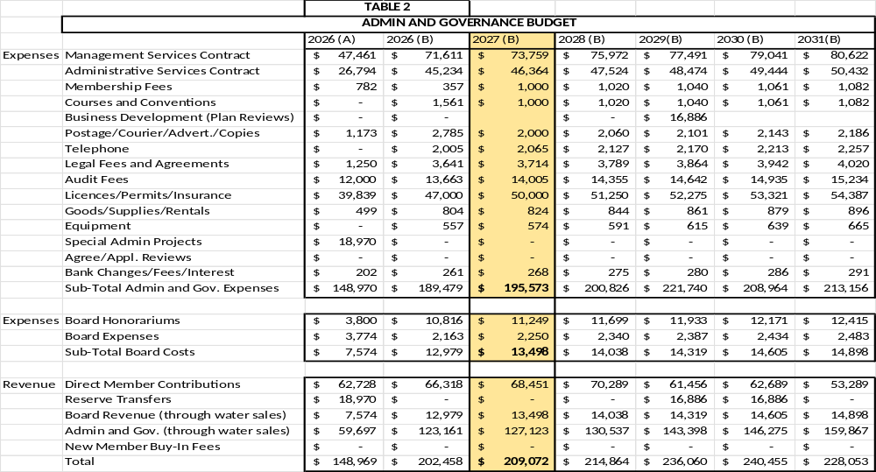
Table 2 – Admin and Governance

Slide 7
Table 2 Notes:
65% of A&G Covered by Water Sales (70% by 2029)
  100% of Board Costs Covered by Water Sales
New Member Fees Removed From Budget (But Not Forgotten!)
  Do You Agree?
Next Business Plan Review in 2029
  Also, New Admin Special Projects Line

Slide 8
Table 2 Notes:
Phase 5(a) Commissioned:
  New Insurance Costs to Include (Estimated +~$3,000)
Tweaking Membership, Conferences, and Postage/Ads:
  Board Thoughts on Some Marketing Material (Merch., Mailouts, Etc.?)
General Inflation ~2% as per Business Plan Variables
Net Impact 3.22% Increase ($6,000) with ½ of it due to Insurance Increases

Slide 9
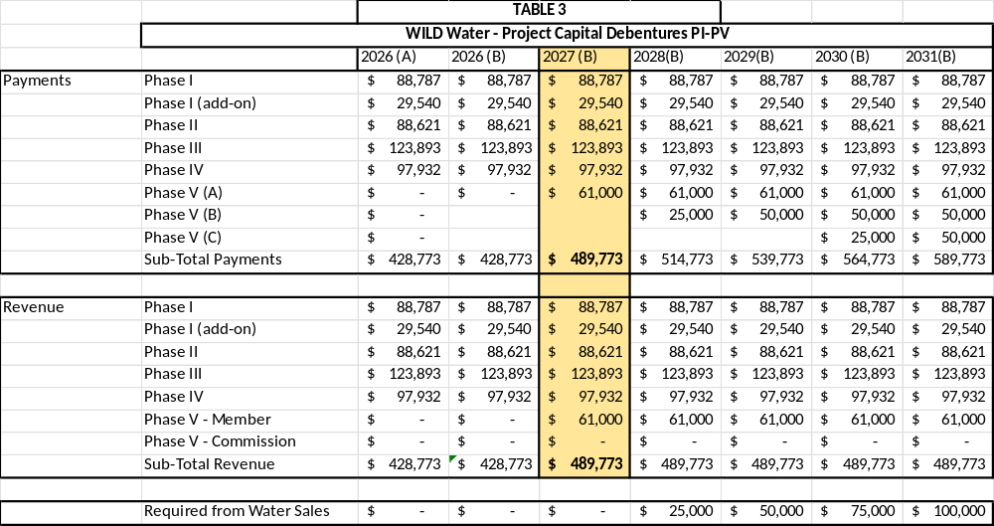
Table 3 – Debentures

Slide 10
Table 3 Notes:
Major Updates:
  Phase 5(a), 5(b) and 5(c) Construction Schedule/Projections
  Phase 5(a) “Known” Debenture Costs and Member Revenue for Same
  Phase 5(b) “Working Expectation” of Debenture Costs, Starting 2028
  Phase 5(c) Estimated Costs, Pushed Back to 2030
Reduced Scope of Phase 5(b) and 5(c):
  Lower Debenture Cost Expectation
  Less Significant Impact on Water Rates
  … But Not Set in Stone (Yet).

Slide 11
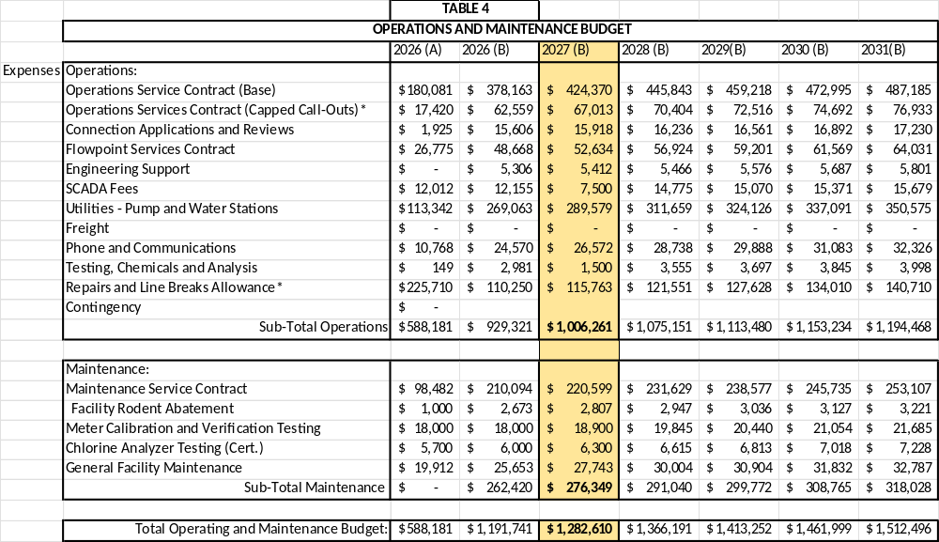
Table 4(a) – Operating

Slide 12
Table 4(a) Notes:
O & M Contract Adjustments:
  Phase 5(a) Integrated Over 2 Years (Some in 2026, Balance in 2027)
  New Sites, New Obligations
  No Expected (Upward) Adjustments for Phase 5(b)
SCADA Annual Charge Adjustment:
  Down (~$5000)
Possible Reduction in Utility Cost???
  Based on Current Actuals (42% Consumed on 7/12 of the Year)
7.6% Increase in 2027
  Down to 3% (~Annual Inflationary) Over the 5-Year Balance

Slide 13
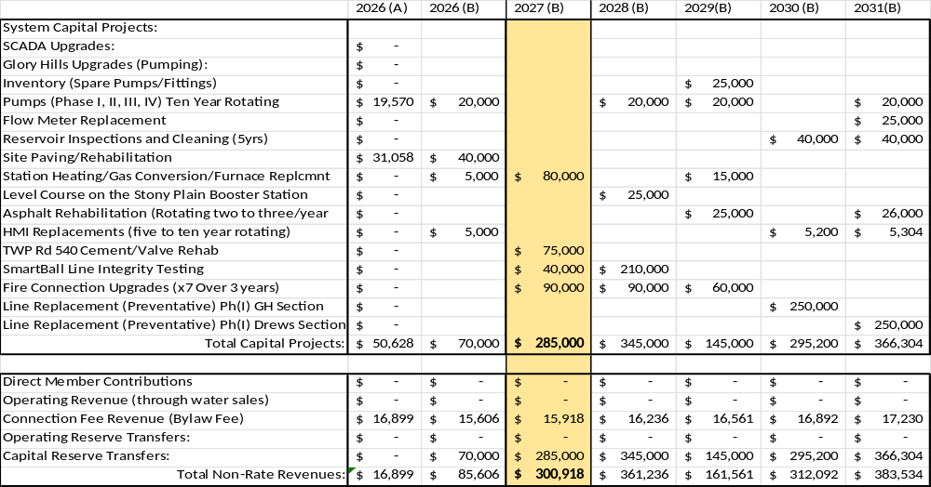
Table 4(b) – System Capital

Slide 14
Table 4(b) Notes:
Significant Review of the Capital (System Capital) Plan Over 2026:
  Addressed a Few Big Issues in 2026 (Under Phase 5(a))
  Draft Includes Some Prospective Board Priority Items (SmartBall, etc.)
  Draft Integrates New Operations Priorities (Feeding Off AMP and Wish List)
Speaking of “Wish List:”
  Current Draft Is Exactly That – Everything We Want, Illustrative for Discussion
  Q: What Can/Must We Keep…
  A: What Can We Include in Phase 5(b)??? ….. Perhaps The Following……

Slide 15
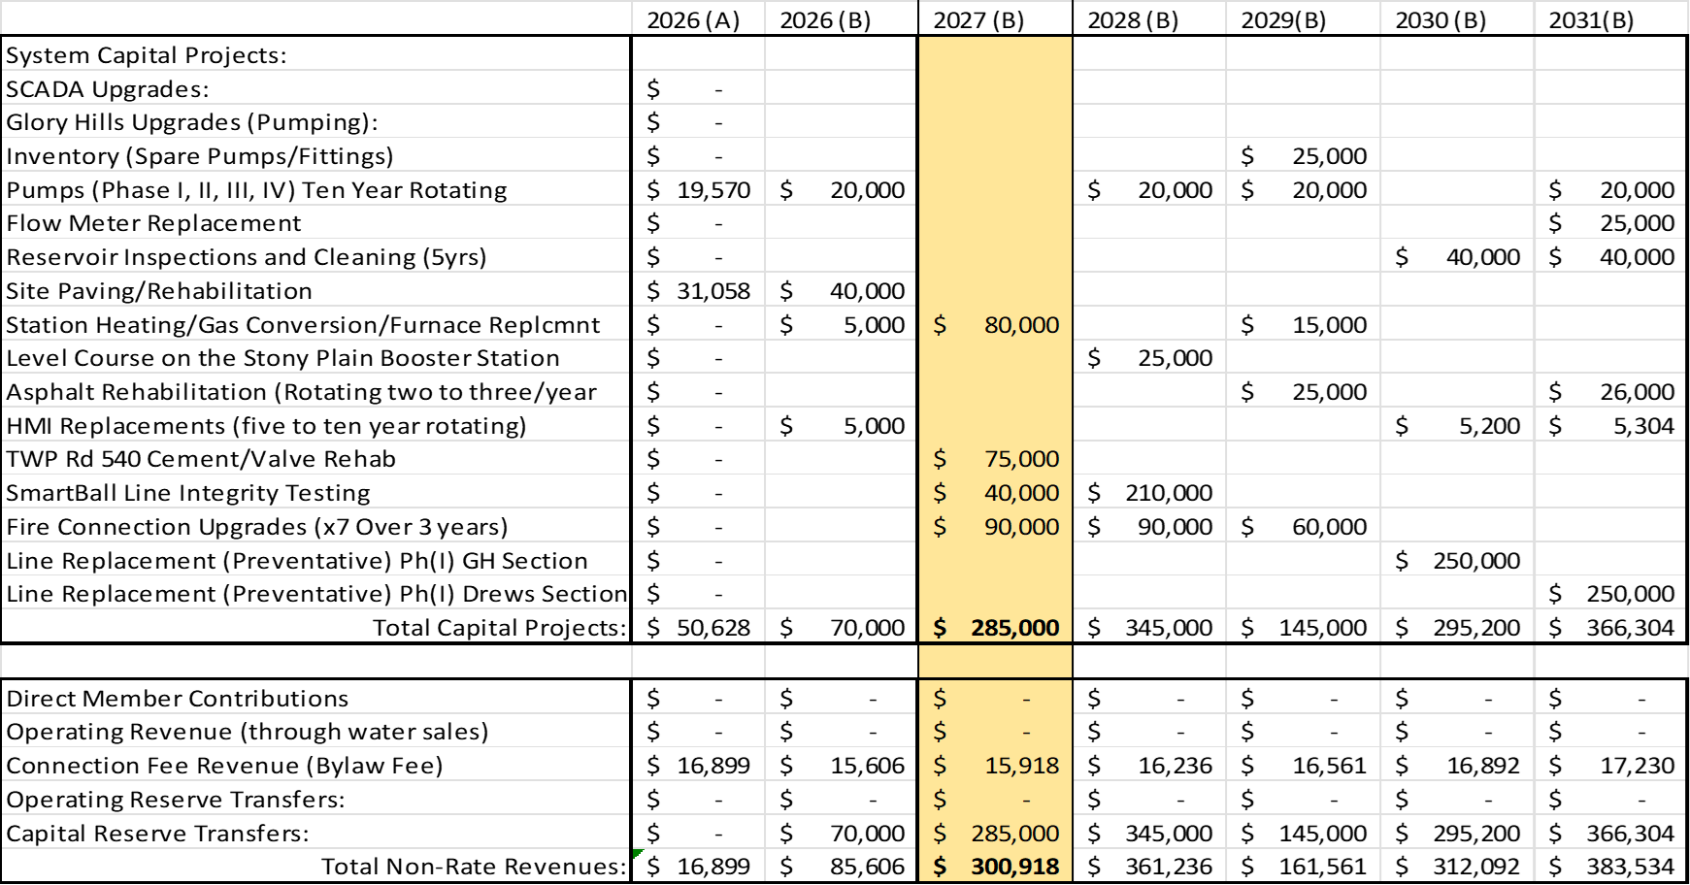


Table 4(b) – System Capital

Slide 16
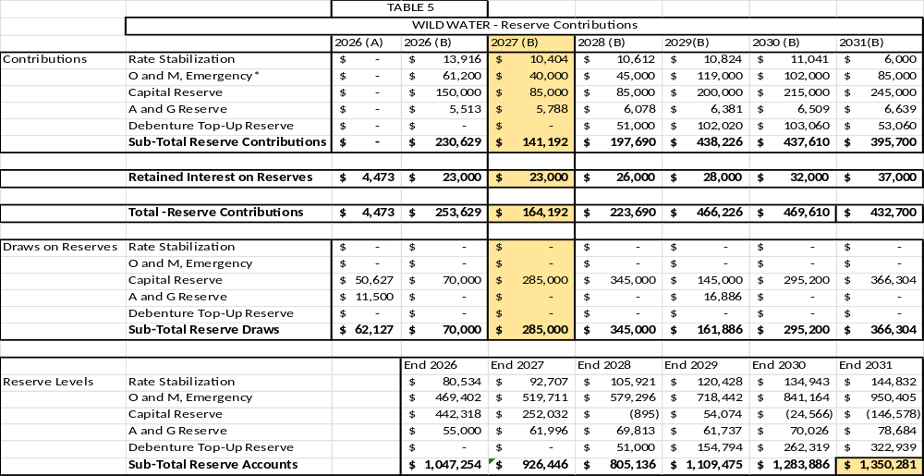
Table 5– Reserves

Slide 17
Table 5 Notes:
Reserve Policy as the Rate Playground:
  Long-term Goals ($2million+ by 2030)
  Short-term Goals (Predictable, Stable, Moderate Rate Increases)
Why Are We Showing So Far Off the $2 Million Goal?
  Actually, We Are Not Far Off – But We Need to Make Some Decisions On the Capital Wish List First.
  For Example, If All of the “Possible” System Capital Items in Table 4 Are Covered Under 5(b), rather than Commission Reserves…. WILD Would Be at ~1.8Million +/- by 2030.
Main Goal Today in This Draft:
  To Moderate Reserve Expectations Until Sales Projections Step Up Again (2028/29)

Slide 18
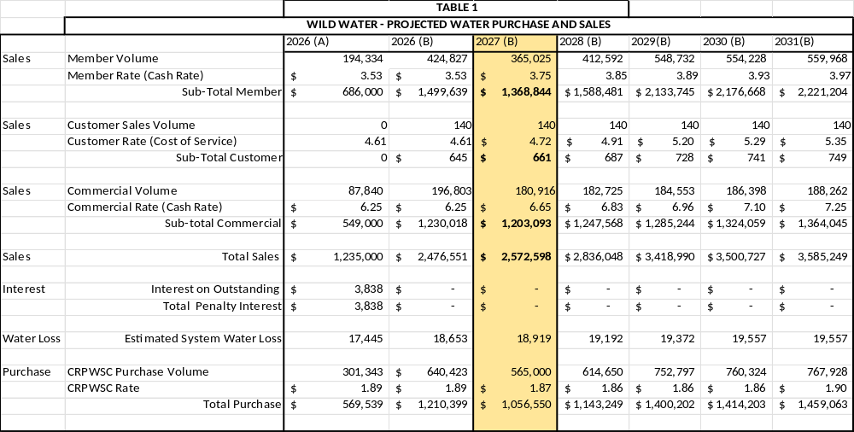
Table 1– Rates and Sales

Slide 19
Table 1 Notes:
Water Sales Projections, Usually Pulled from Business Plan, and Usually On Target:
  2026 Actuals Are Frustratingly Off Target
  ~10% Below Expectations, Universal Trend (Why?)
  For This Draft, We Assumed a Worst Case – That Lower Sales Is A Trend, Not an Anomaly
New Rates:
  Members - $3.75/m3 (6.2% Increase) – 65% of Sales
  Truck Fill - $6.65/m3 (6.4% Increase) – 35% of Sales
  Customer – $4.72/m3 (3% Increase) – <0.25% of Sales
Water Loss Allowance Within 3%, CRPWSC Rates As Projected:

Slide 20
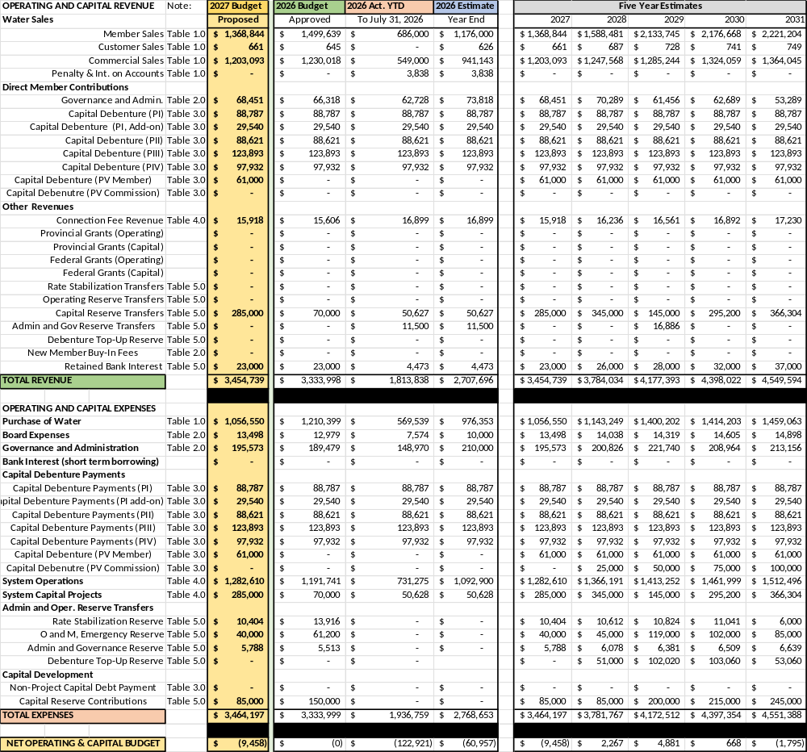
Summary Ledger Budget 2027

Slide 21
Master Ledger Summary
Scale of Budget 2027-2031
Scope of Budget 2027-2031
Budget 2027 Represents A Contraction In Operating Scope, In Real Terms
3.75% Increase Overall, If You Factor In New Debentures and the Full Capital Wish List
Still On Track to Hit Over $4.5M within 5-Yr Frame.
Growth Forecast Strong, But Delayed
2026 Reference Year a Shock, Still Assessing
Planning Wisely to Cover Capital Works Within Phase 5(b) Scope (Efficiency)
Managing Service Delivery Expectations with Cost Management, Value for Money, Enhanced Customer Experience

Slide 22
Not Done Yet:
Early Days in the Budget Process - Many Figures Are Yet to Settle Out:
  CRPWSC Rates, 2026 Actual Costs for Reference, Insurance Renewal
Primary Aim At This Point:
  Confirm that the Recipe is Right, Not Necessarily If We Have all the Ingredients Yet.
  Most Business Plan Methodologies Are Holding; Some (Water Projections) Need A Revisit.
Regardless of the Volume Shock and Line Breaks (Est.: -$400,000 impact):
  Still Projected to be Near Break-Even (Estimating ~2% Net Loss for 2027)
  Things We Can Control We Are Controlling Well
The Next Draft Will Be More Refined, And With The Board’s Input, More Focused, Too.

Slide 23
Key Observations to Factor In for 2027
Completion of Phase 5(a), Updated Phase 5(b) Timelines/Impact:
  Debentures, Insurance, Operations and Maintenance Adjustments
Revisions to Member and Member Connection Timelines:
  Legal Costs, New Water Sales Opportunities (and Obligations).
Water Sale Figures – New Trends or Abnormalities?
  Assessing the 2026 Water Sales and Predicting 2027-2031
Service Level Changes and Needs:
  Preparing to Negotiate New Management, Admin and O&M Contracts
  New System Capital “Wish List”
Advocacy, Engagement and Marketing:
  Board Priorities for Protecting, Connecting and Expanding WILD

Slide 24
Next Steps:
Discussion?
Member Engagement
Final Review and Approval
Rate Bylaw
Member and Customer Notices

